Slide 1
QR CODE BASED RECOGNITION AND TRACKING IN A GUI DRONE
Group:
Velayudhan A : AM.EN.U4EEE17101
Nandakishore R Nair: AM.EN.U4EEE17123
Neeraj S : AM.EN.U4EEE17124
Vishnu S : AM.EN.U4EEE17147
Mentor : Mr Vivek
Asst. Professor, Electrical and Electronics,
School of Engineering, Amritapuri

Slide 2
Introduction
Dynamic remotely operated navigation equipment (DRONE) is the state of art technology that is most often associated with the military ,where they were used initially for anti-aircraft target practice intelligence gathering and then,more controversially,as weapons platform.Drones are now also used in a wide range of civilian roles ranging from search and and rescue, surveillance , traffic monitoring, weather monitoring and fire fighting , to personal drones for photography , agriculture and even delivery services.
The proposed system is composed of a Quick Response (QR) Code analyser mounted on board an unmanned aerial vehicle (UAV) along with on board processor, which allows the drone to be versatile enough in order to specifically to be used in object recognition,Human tracking, navigation, moving body identification, godown inspection, etc.

Slide 3
Classification of drones
Multi-Rotor Drones.
Fixed-Wing Drones.
Single-Rotor Helicopter Drones.
Fixed-Wing Hybrid VTOL.

Slide 4
Design parameters
Aerodynamics
Payload
Endurance
Speed and range
Communication
Navigation system
Launch and recovery
Recognition distance
Tracking efficiency

Slide 5
Applications of UAVs
Search and rescue
Disaster relief
Sports
Commercial aerial surveillance
Armed attacks
Tracking

Slide 6
Objectives of the project
Creating Halftone QR codes
QR based recognition
Tracking of objects

Slide 7
LITERATURE REVIEW
Recognition System for QR Code on Moving Car
The Paper proposed a system which reads QR code from a moving object by recording a video file.
The moving object was subjected to different speeds and analysing video files.
QR Code abbreviation for Quick Response Code was first developed by Denso Wave corporation. It can hold a significant amount of data in a 2D matrix format using function pattern and encoding region, along with contrast limited adaptive histogram equalization. In simple words histogram equalisation is to stretch the histogram of a image to either sides, as the brighter image have all images confined to high values.

Slide 8
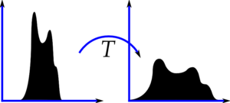
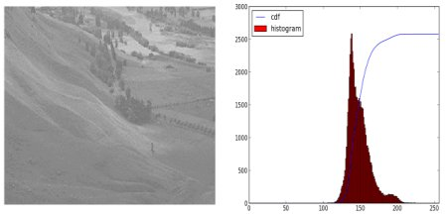
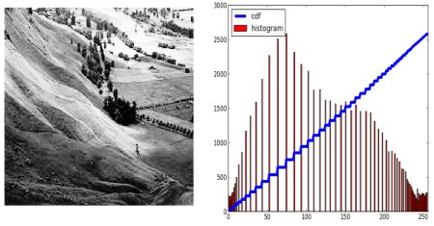
From the figures in the slide you can get a rough sketch of what is histogram equalisation is. It can be achieved in the opencv by the cv.equalizeHist. But the drawback is that the said technique only applies to the global picture which means as the picture in the whole.

Slide 9
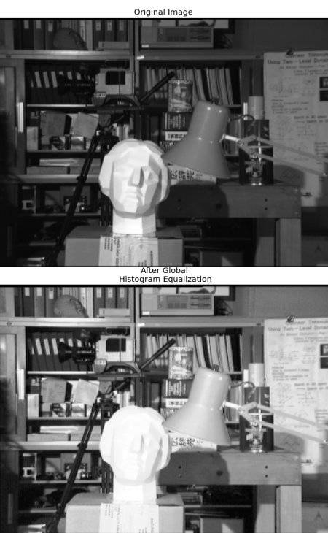
CLAHE (CONTRAST LIMITED ADAPTIVE HISTOGRAM EQUALISATION)
For the example given the slide after histogram equalisation even though the background data has been improvised but the data of the facial images of the scupture is lost which is undesirable. In order to avoid that adaptive histogram equalisation where the image is divided into tiles and each block is histogram equalised. In order to avoid noise amplification contrast limiting is applied. After equalisation bilinear interpolation.

Slide 10
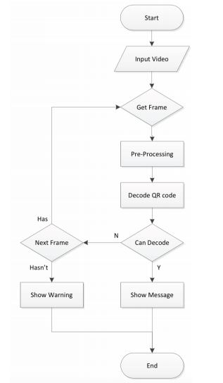
Preprocessing
Grayscale imaging and image intensity adjustments
CLAHE implementation
Image to binary image based on threshold or level and replacing value 1 in areas where image intensity is greater than the level or threshold and all other value as 0.
Level is normally set at the mid value.

Slide 11
Structure From Motion Technique for Scene
Detection Using Autonomous Drone Navigation
yo-Ping Huang.http/IEEE.com, Senior Member, IEEE, Lucky Sithole, and Tsu-Tian Lee, Fellow, IEEE
From this paper information about scene detection and estimation using high-resolution imagery acquired through autonomous drone navigation aided with landmark detection and recognition. The drone can capture images and provide real-time video streaming of the ground cover using a camera.
Autonomous Navigation - For safe and efficient navigation, we are be able to localize them autonomously using their onboard sensors and interpretation of the unknown environment features.Tit is a vision-based target detection and localization system.
The regions of interest (ROIs) in each video frame during the flight and triggers autonomous responses based on the detected landmark and the current drone status.

Slide 12
Eye in the Sky: Drone-Based Object Tracking and 3D Localization
Haotian Zhang∗ haotiz@uw.edu University of Washington Seattle, Washington
Gaoang Wang gaoang@uw.edu University of Washington Seattle, Washington
Zhichao Lei zl68@uw.edu University of Washington Seattle, Washington
Jenq-Neng Hwang hwang@uw.edu University of Washington Seattle, Washington
In this paper, a multi-object tracking and 3D localization scheme is implemented based on the deep learning based on object detection. A multi-object tracking method called TrackletNet Tracker (TNT) which utilizes temporal and appearance information to track detected objects located on the ground for UAV are applied can be used for the project . The following novelties such as Accurate object detection , Multi-object tracking , Visual odometry and ground plane estimation , 3D object localization these can be implemented in our project .

Slide 13
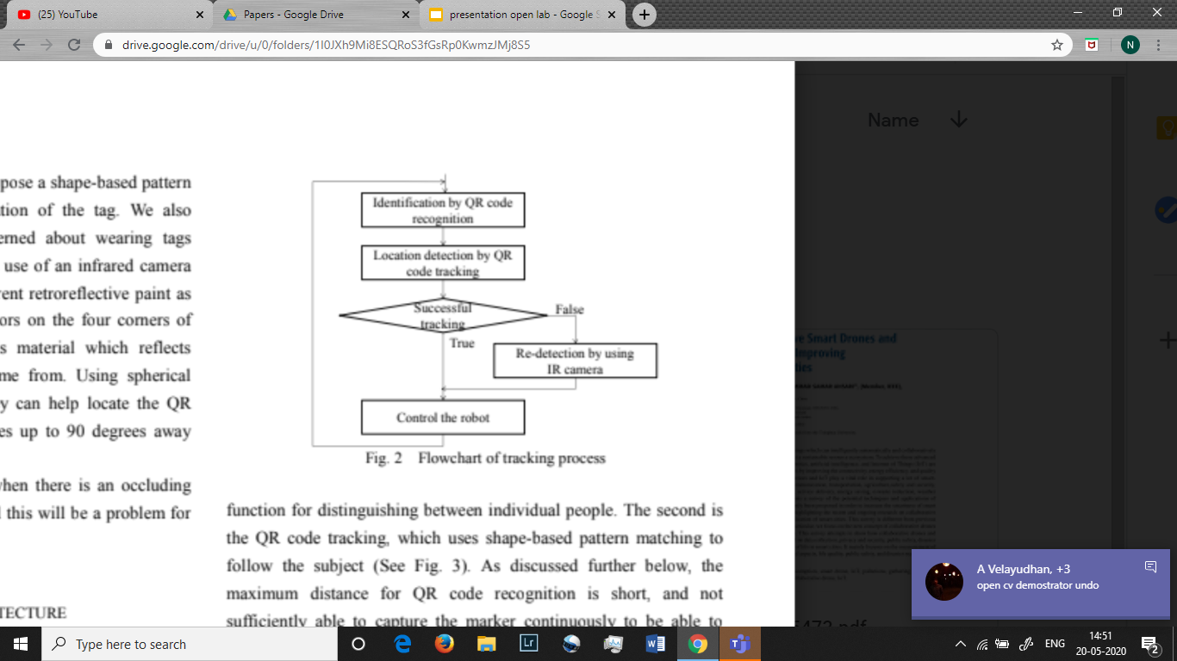
Development of a Human-Tracking Robot Using QR Code Recognition Takashi Anezaki* ,Koki Eimon* ,Suriyon Tansuriyavong* ,Yasushi Yagi**
In this paper they conducted research on human-tracking robots. They implemented a tracking system which differentiates individuals using QR codes and tracks subjects using shape-based pattern matching. They also proposed a rediscovery process using an IR camera to handle cases when the QR code strays completely out of the camera field of vision.
There are three main requirements for realizing
a human-following robot:
(a) Continuous identification of the individual person being
followed.
(b) Detection of the location of the person being followed.
(c) Control of the robot based on the detected location data.
Since case (a) is difficult with image processing alone, QR-tag
is used for tracking.

Slide 14
Literature Review
Warehouse Management Using Real-Time QR-Code and Text Detection
Debjoy Saha Indian Institute of Technology Kharagpur
11th INTERNATIONAL MICRO AIR VEHICLE COMPETITION AND CONFERENCE
This paper is about developing the computer vision tools for efficient inventory management of packages of a warehouse using QR code.A industrial camera with 120 fps is used to detect the QR code .The zbar library and google text recognition tesseract are used for QR code recognition and text detection respectively.
In this paper the process of QR code recognition is split into 3 stages .In the first stage the acquired image is rescaled cropped and the distortions are removed by blurring .The image is cropped to convert the QR code part of the video feed into a jpg file ..In the next stage the image obtained is passed to the z bar library and the qr code is detected and decoded. In the next stage the image is preprocessed and passed to tesseract for text recognition.In this project this decoded information is used to arrange the warehouse goods in their respective places .This paper provides the overview of the two main methods used for specific object detection that is QR code detection and text detection and explains the necessary algorithms required for carrying out this process.
The paper provides an overview of the necessary tools for image recognition, QR code decoding and text recognition .The paper also briefs about the algorithm of preprocessing the acquired image which include rescaling, distortion removal,cropping .The tools and information required for image recognition and decoding like zbar and tesseract which is necessary for our project was obtained from the paper.

Slide 15
Localization and navigation using QR code for mobile robot in indoor environment
Huijuan Zhang, Chengning Zhang, Wei Yang, Chin-Yin Chen, Member, IEEE
IEEE Conference on Robotics and Biomimetics
Zhuhai, China, December 6-9, 2015
The navigation of autonomous robots in environments without gps support is an area least explored. An approach for localization and navigation for a mobile robot in indoor environment using QR code recognition is proposed in this paper.In this paper the possibility of QR codes as a landmark for autonomous robots is explore and explained.
In this paper QR codes are used as a landmark which provides relative location and directions to the autonomous robots or UAVs.Exposure adjustable cameras are used to provide the input feed to the robot.
Unlike the usual QR code detection scenario a different configuration of the zbar library is used in this process.The video feed from the camera is acquired by the opencv for image processing and qr code detection when a QR code is detected an image is captured by the camera and this image is sent to the zbar library after preprocessing . This method improves the accuracy by 20% because zbar is more precise while processing jpg images. The papers also states a possibility of using both the techniques simultaneously for higher accuracy and processing speed.
This paper explains a new and accurate method of QR code recognition and decoding .This paper provides a new dimension and application to QR code detection using UAV in terms of localization and navigation in routine paths as an alternative for gps module

Slide 16
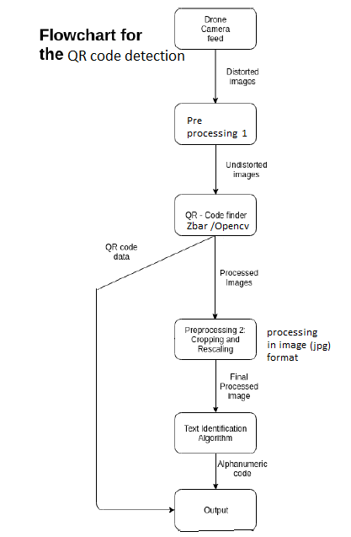
QR Code Recognition
2 ways of QR recognition
Using live feed as input to Zbar library
Accuracy around 60%
Simpler algorithm
Using jpg image capture by camera when opencv image processing detects a QR Code
More accurate than live feed
Faster preprocessing like resizing and cropping
Half tone QR codes can be usedfor camoflaging the QR codes.

Slide 17
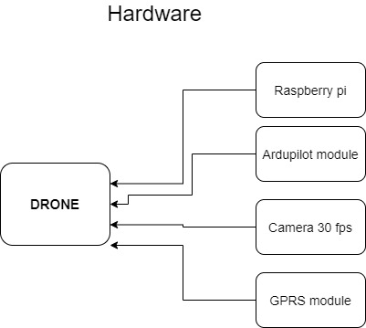
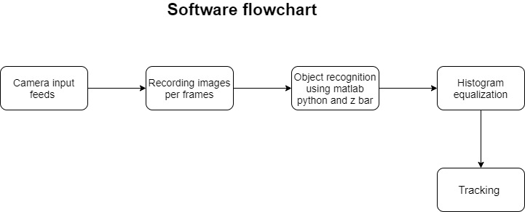
System Description

Slide 18
Project Phases
Phase 1 : object detection using MATLAB and opencv
This phase includes the detection of QR code using opencv and MATLAB
Phase 2: object recognition using Zbar library
In this phase the detected QR code is recognised scaled and undergoes image preprocessing .Then the information from the QR code is decoded
Phase 3: object tracking
This phase includes tracking of the object based on the video feed given to the opencv and Zbar libraries

Slide 19
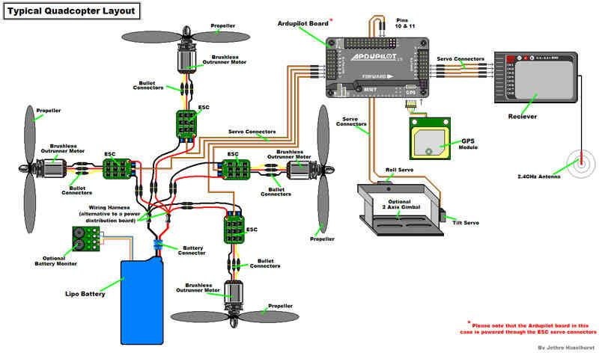
Hardware Layout

Slide 20
The Object detection phase
The first phase which includes Object detection was simulated using the teachable machine by Google and the outcome is as shown.

Slide 21
Project outcome
Expected in obtaining a cost effective and autonomous system for facilitating
A QR Detection and analyzing module for object detecting .
Human tracking using QR code tag .
Qr code based Navigation system for routine path .

Slide 22
References
[1]Recognition system for QR Code on Moving Car ,
The 10th international conference on computer science and education, (ICCSE 2015) cambridge university, UK
[2]Development of a Human-Tracking Robot Using QR Code Recognition
Takashi Anezaki* ,Koki Eimon* ,Suriyon Tansuriyavong* ,Yasushi Yagi**
[3]Eye in the Sky: Drone-Based Object Tracking and 3D Localization
Haotian Zhang∗ haotiz@uw.edu University of Washington Seattle, Washington ,Gaoang Wang gaoang@uw.edu University of Washington Seattle, Washington ,Zhichao Lei zl68@uw.edu University of Washington Seattle, Washington .Jenq-Neng Hwang hwang@uw.edu University of Washington Seattle, Washington
[4]Localization and navigation using QR code for mobile robot in indoor environment
Huijuan Zhang, Chengning Zhang, Wei Yang, Chin-Yin Chen, Member, IEEE
[5]Warehouse Management Using Real-Time QR-Code and Text Detection,Debjoy Saha,IIT Kharagpur
https://www.researchgate.net/profile/Debjoy_Saha/publication/336218818_Warehouse_Management_Using_Real-Time_QR-Code_and_Text_Detection/links/5d9795ac299bf1c363f8d4d6/Warehouse-Management-Using-Real-Time-QR-Code-and-Text-Detection.pdf

